Slide 1

Chicago Average Temperature Forecasting
MSCA 31006 Time Series Analysis and Forecasting
Team 2:
Daisuke Kageyama, Harsha Muthukuru,
Isha Sharma, Suyash Lakhani, Yuki Hirayama
Notes:
yif

Slide 2





Agenda
1.Problem Statement and Objective
2.Dataset Overview
3.Exploratory Data Analysis (EDA)
4.Modelling
Daisuke Kageyama
Harsha Muthukuru
5.Model Evaluation and Selection
6.Forecasting (Selected Model)
7.Insights and Recommendations
8.Conclusion and Future Work
Isha Sharma
Suyash Lakhani
Yuki Hirayama
Notes:
yif

Slide 3
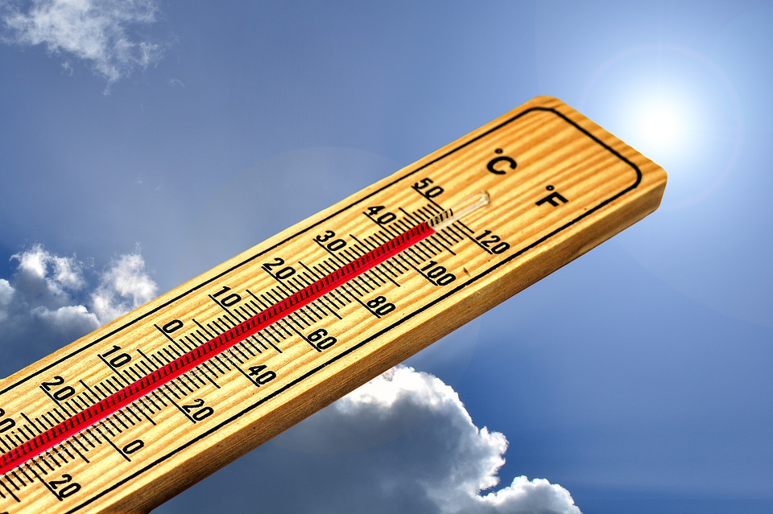

1. Problem Statement and Objective
Problem Statement:
Accurate daily temperature forecasting plays a crucial role for effective decision-making and planning in various domains, including agriculture, energy management, and urban planning.
However, the complex nature of temperature patterns, influenced by seasonal changes and long-term trends, presents a challenge in developing reliable forecasting models. Therefore, the problem at hand is to address this challenge and create a robust forecasting solution that captures the intricate dynamics of Chicago's daily temperature fluctuations.
Objective:
The objective of this project is to leverage time series analysis and forecasting techniques to create a robust model that can forecast average daily temperature variations in Chicago with high accuracy to help enable stakeholders to anticipate temperature trends and make informed decisions.
https://pixabay.com/illustrations/thermometer-summer-hot-heat-sun-4767443/

Slide 4

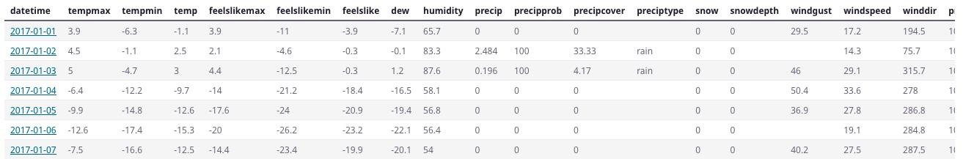
2. Dataset Overview
This project used the open data from Visual Crossing.
The dataset includes 4,018 observations from 05/01/2012 to 05/01/2023.
The dataset has 33 features regarding the past weather in Chicago, like the maximum temperature, minimum temperature, wind speed, humidity, etc.
We used the observations between 05/01/2012 and 04/30/2021 as train data, and the observations 05/01/2021 and 05/01/2023 as test data.
Target variable for forecasting - Avg Temp
Assumption: Throughout our analysis and modelling, we made the assumption that the values provided in the dataset are accurate and reliable.
https://www.visualcrossing.com

Slide 5
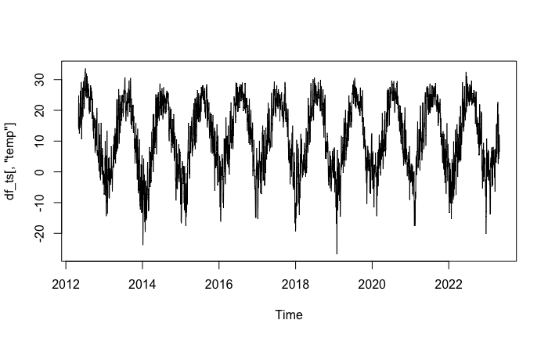
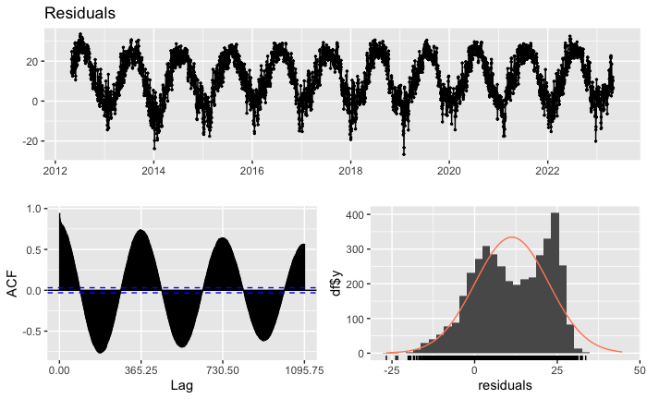
3.1 EDA: Data Observation
The plot shows that there is no clear upward/downward trend.
The plot shows seasonality - with higher temperatures occurring during summer months and lower temperatures during winter months.
The ACF values are greater than the critical values, implying non-stationarity.
The distribution of residuals does not align with the normal distribution.

Slide 6
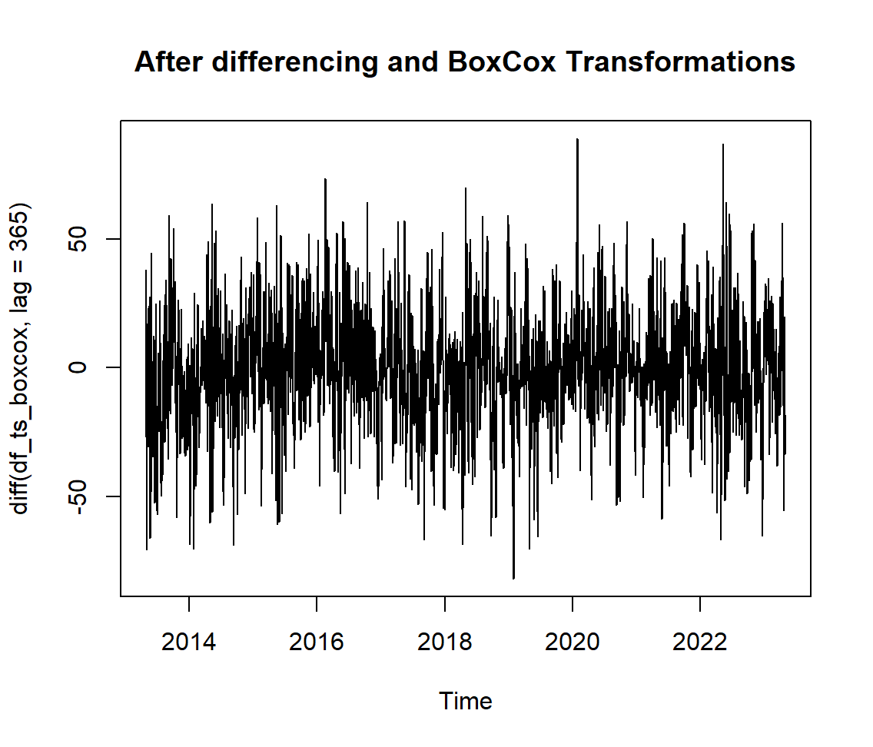
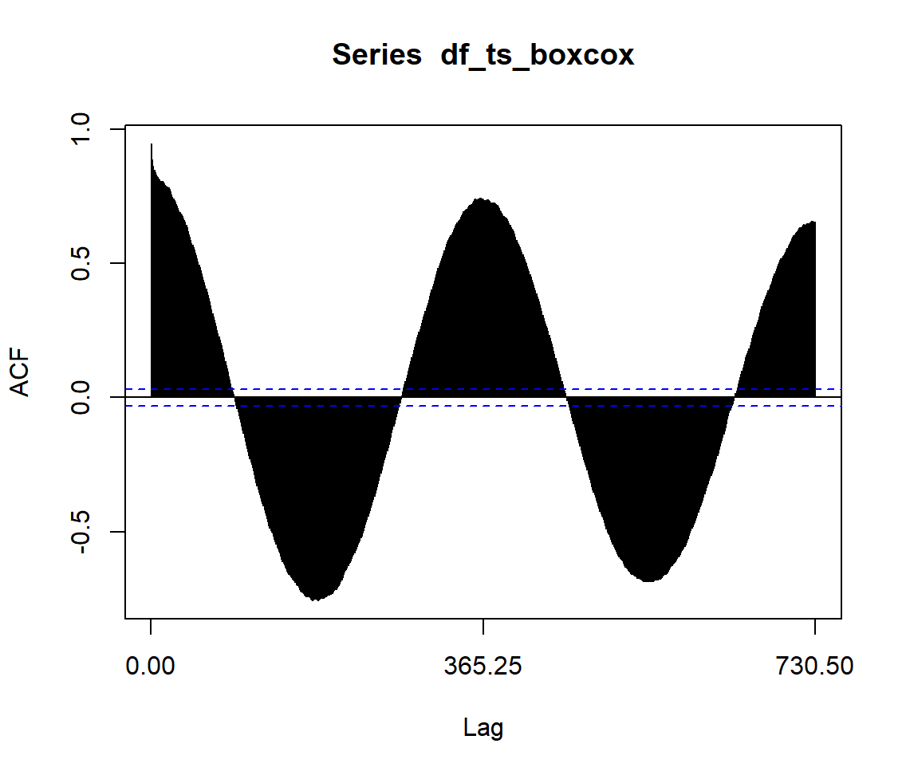
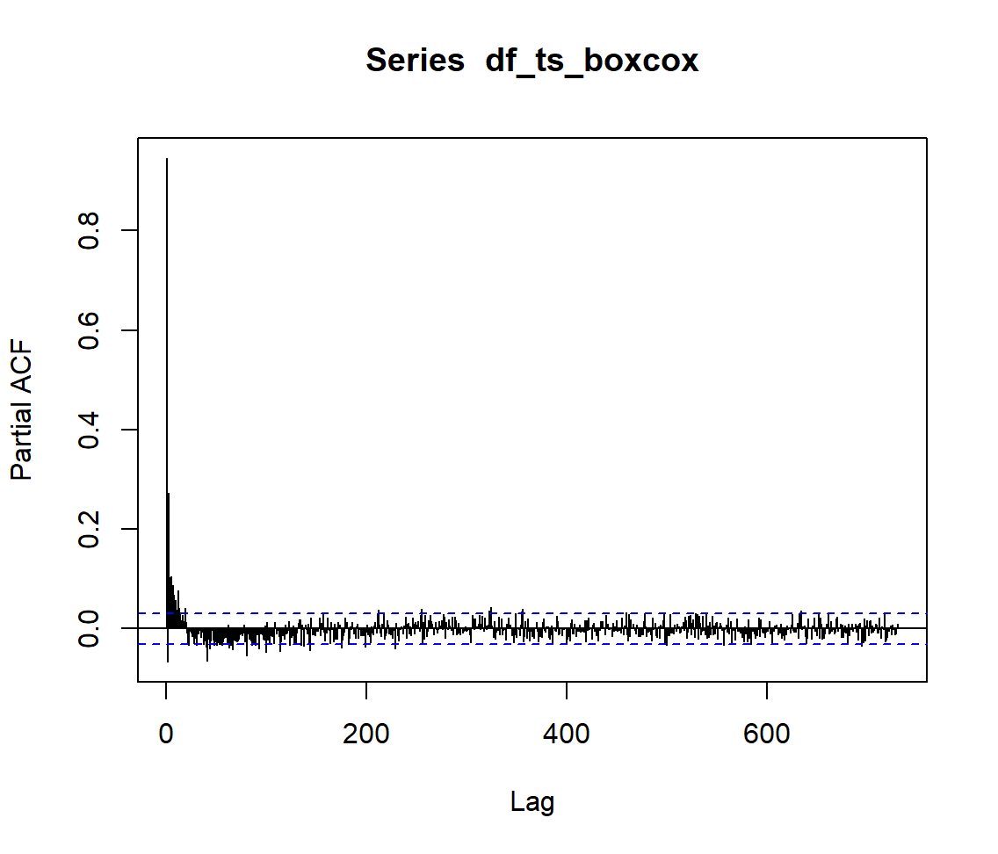
3.2 EDA: Data Transformation
We applied the Box-Cox Transformation to the dataset to stabilize the variance.
Then, we took the first-order difference of the seasonal component of the data to make data stationary.
KPSS test suggests that the data is stationary whereas ADF test suggests the opposite
KPSS test backed up the plot of the data, so we concluded that the data is stationary for seasonal differencing. ACF is decaying and PACF cut off is at lag 1

Slide 7
4. Modeling Overview
We build the following models for forecasting the average daily temperature between 05/01/2021 and 05/01/2023.
Holt-Winters: We employed the Holt-Winters method, which is a triple exponential smoothing technique, capable of capturing both trend and seasonality in the data. This approach was suitable for our dataset given its clear seasonal patterns.
ARIMA: Another modeling approach we utilized is ARIMA (Autoregressive Integrated Moving Average). ARIMA allowed us to capture the autocorrelation and seasonality in the data while accounting for differencing to achieve stationarity.
Regression: We also explored regression models to incorporate external factors that may influence temperature variations, such as humidity or wind speed.
LSTM: Long Short-Term Memory (LSTM), a deep learning-based approach, was employed to capture complex temporal dependencies in the data.
VAR: The Vector Autoregression (VAR) model was used to capture the interdependencies between the temperature features, allowing for more comprehensive forecasting.

Slide 8
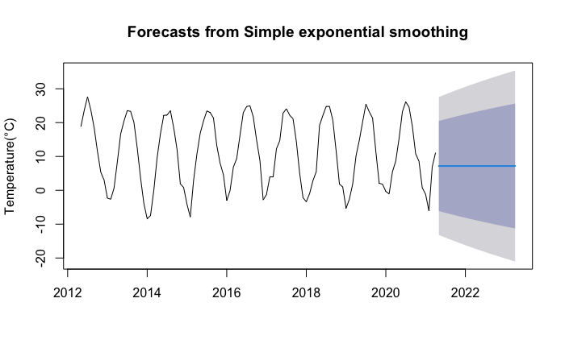
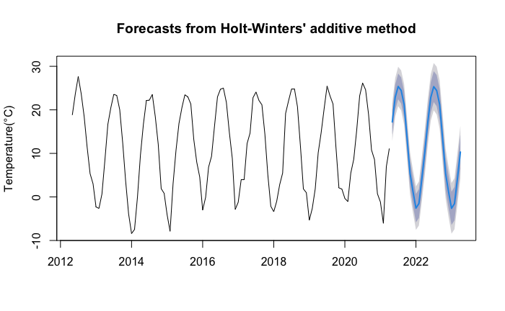
4.1 Modeling: Holt-Winters Seasonal Method
The data shows seasonality, so the simple exponential smoothing, which provide flat forecast, which will not be appropriate. So, we used Holt-Winters Seasonal Method.
We used additive method since the seasonal variations are roughly constant through the series.
For the test data, the Root Mean Square Error(RMSE) was 1.52. The AICc value was 701.57.

Slide 9
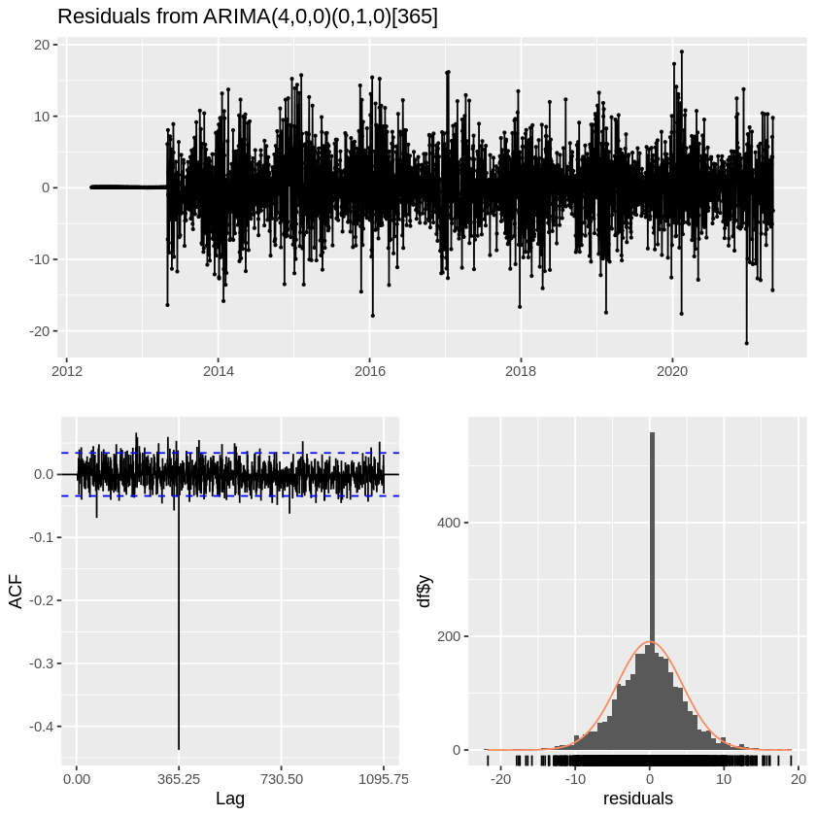
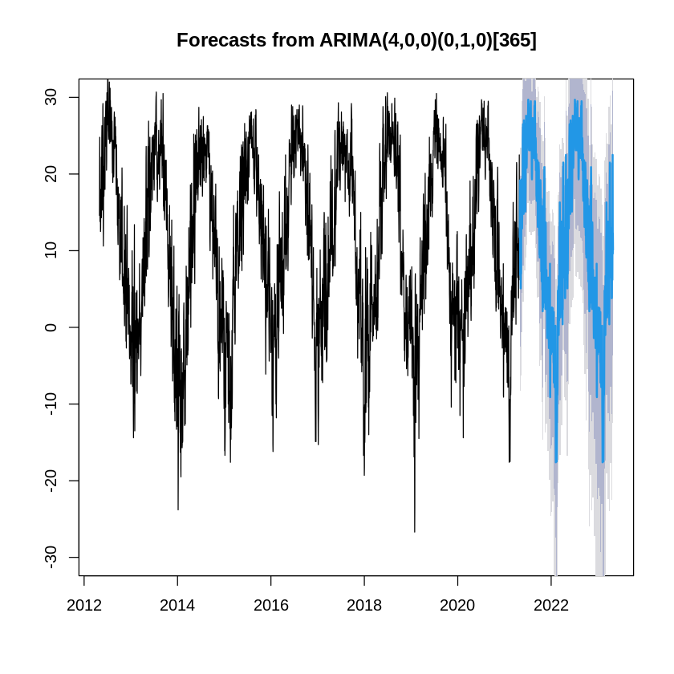
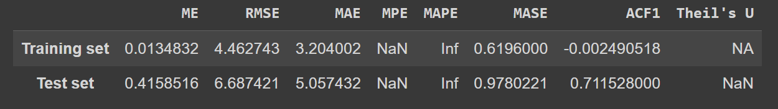
4.2 Modeling: ARIMA
To build the ARIMA model, we started with the MA(1) model which gave us a result of (0,0,1) and we used (0,1,0) for seasonal component (first differencing)
Using auto.arima() we got the best model as ARIMA(4,0,0)(0,1,0)[365]
We then compared this model with other possible models from EACF matrix (1,3) which resulted in a better AICc value but not RMSE
We finally chose the ARIMA(4,0,0)(0,1,0)[365] model which gave us an RMSE of 6.68 and AICc value of 40958.56
Stats of model from auto.arima()

Slide 10
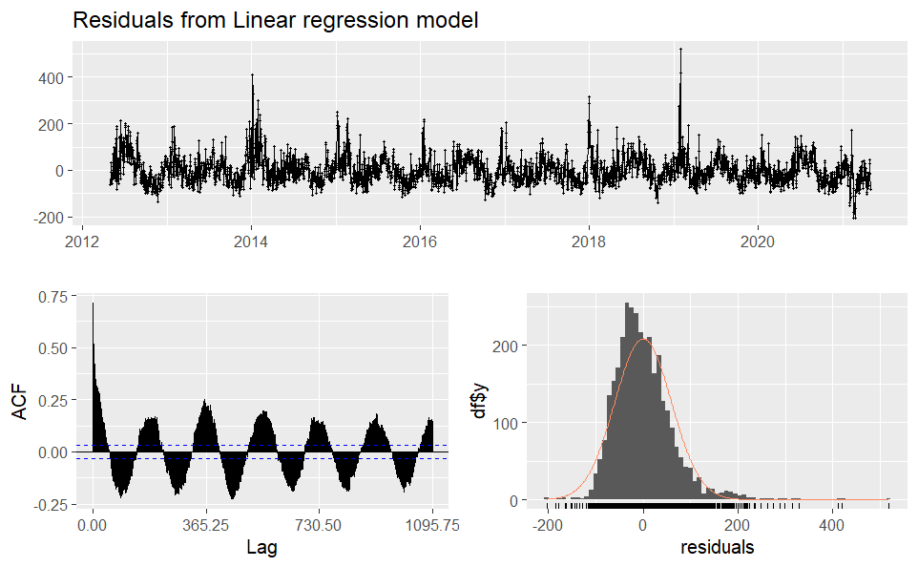
4.3 Modeling: Regression with ARIMA errors
For a regression analysis, forward stepwise selection suggested the independent variables as dew, humidity, snowdepth, winddir (wind direction), sealevelpressure, coludcover, and visibility.
Plotting the ACFs of the residuals revealed clear autocorrelation. So, we used regression with ARIMA errors.

Slide 11
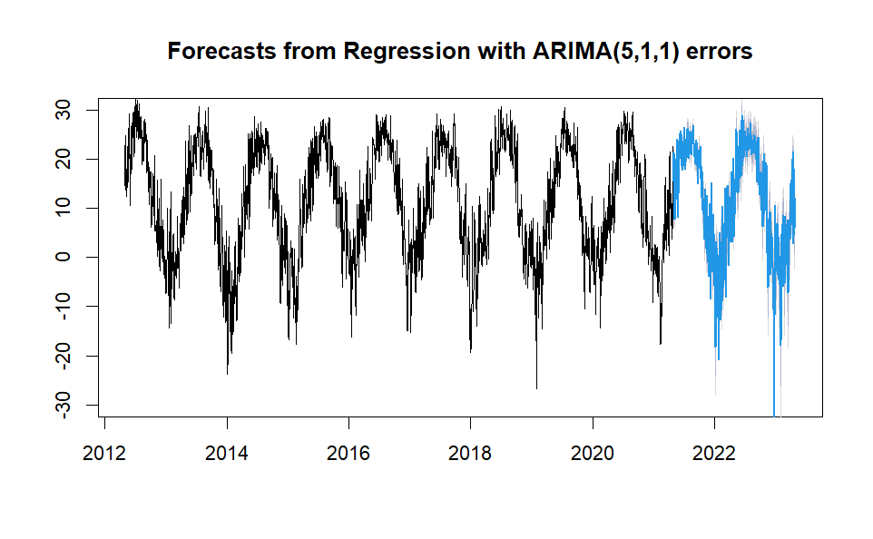
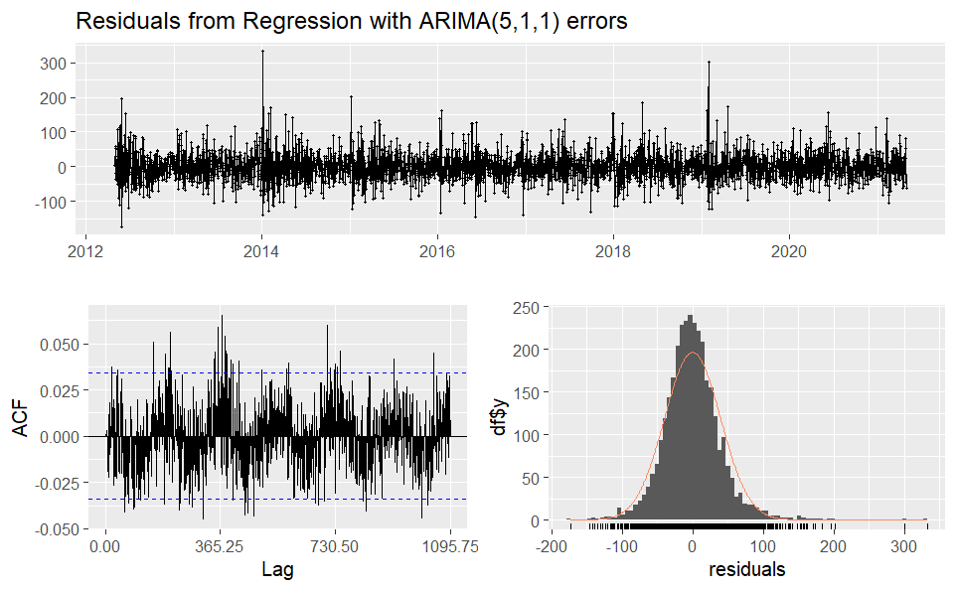
4.3 Modeling: Regression with ARIMA errors
Based on auto.arima() suggestion, we did Regression with ARIMA(5, 1, 1) errors.
AICc was 33556.89
The Root Mean Square Error(RMSE) was 1.31 for the test set.
The ACFs of the residuals looks better than the just regression model, but there was still significant autocorrelation in the residuals. (Ljung-Box Test p-value < 0.05)

Slide 12
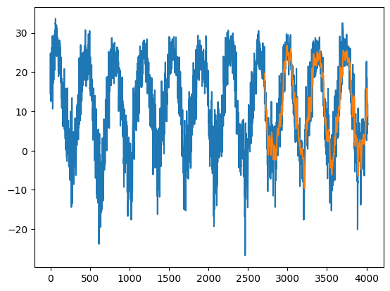
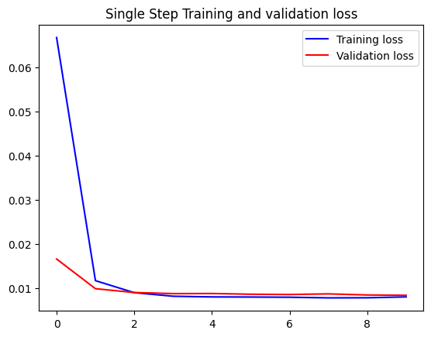
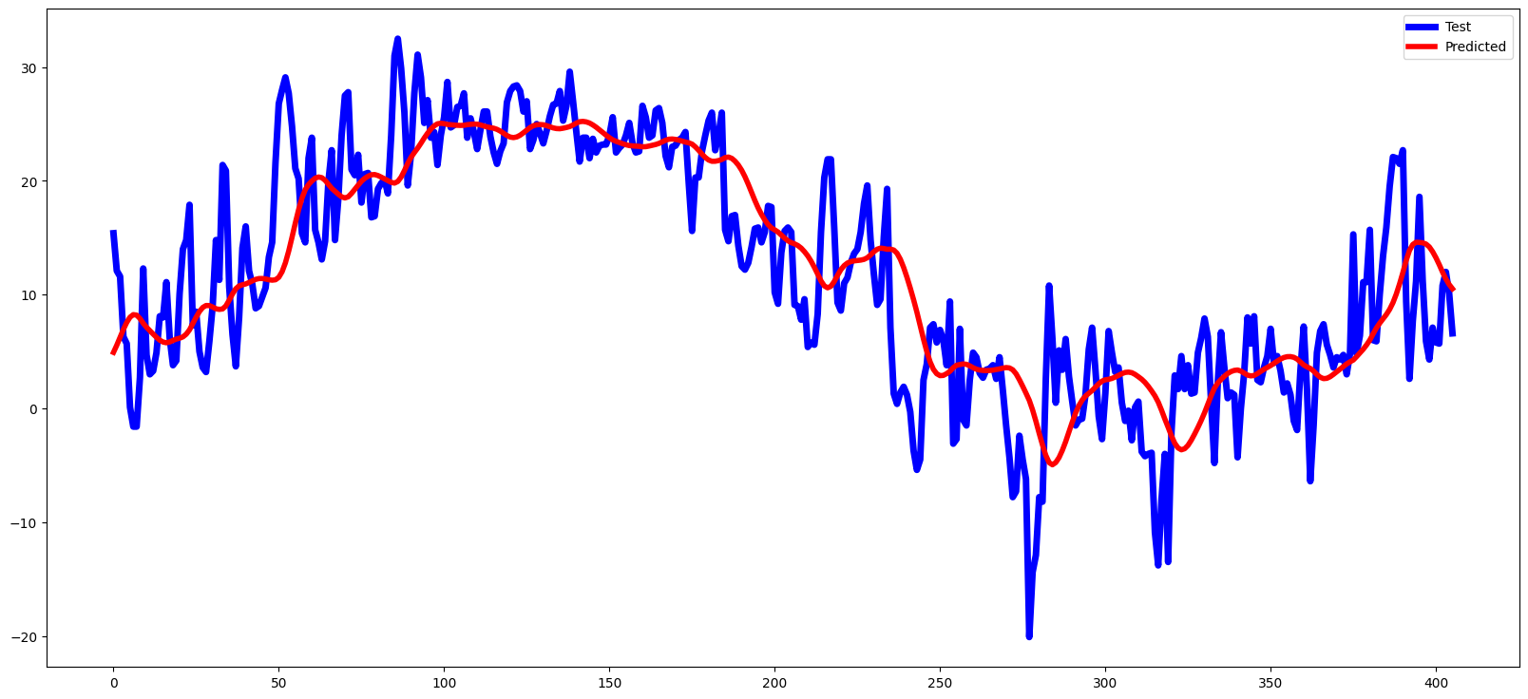
4.4 Modeling: Long Short Term Memory Model
Long Short-Term Memory (LSTM), a deep learning-based approach, was employed to capture complex temporal patterns in the data.
We created a LSTM with 2 LSTM layers, recurrent dropout and batch normalization layers to prevent overfitting and a final dense layer for the output prediction. We also used early stopping to prevent overfitting.
The model when evaluated on the test data gave us an RMSE of 5.535.
LSTM - predicted (orange) vs actual (blue) values
Actual vs Predicted Values
Temperature
epochs

Slide 13
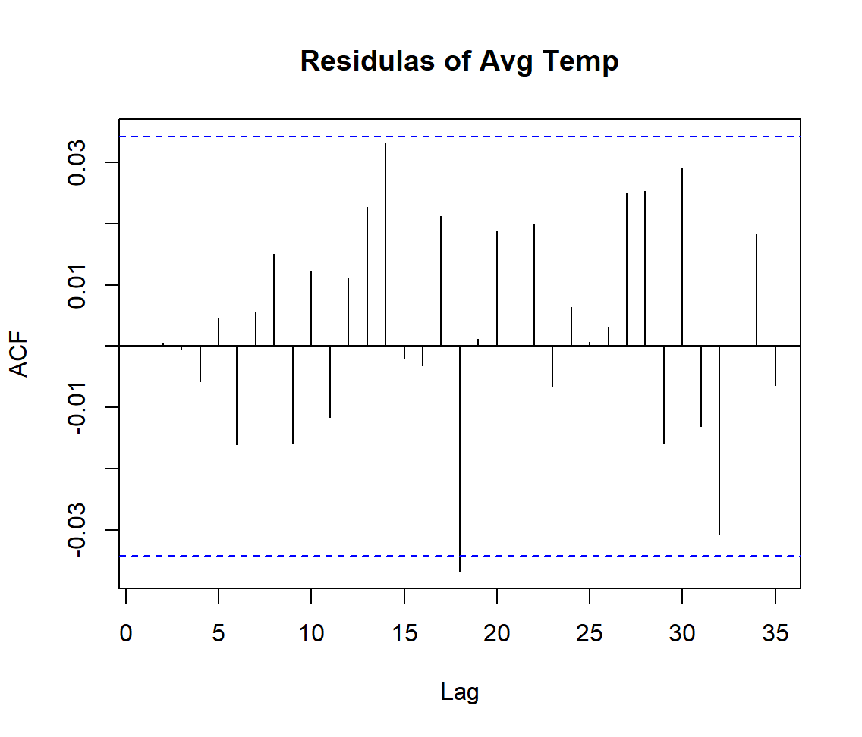
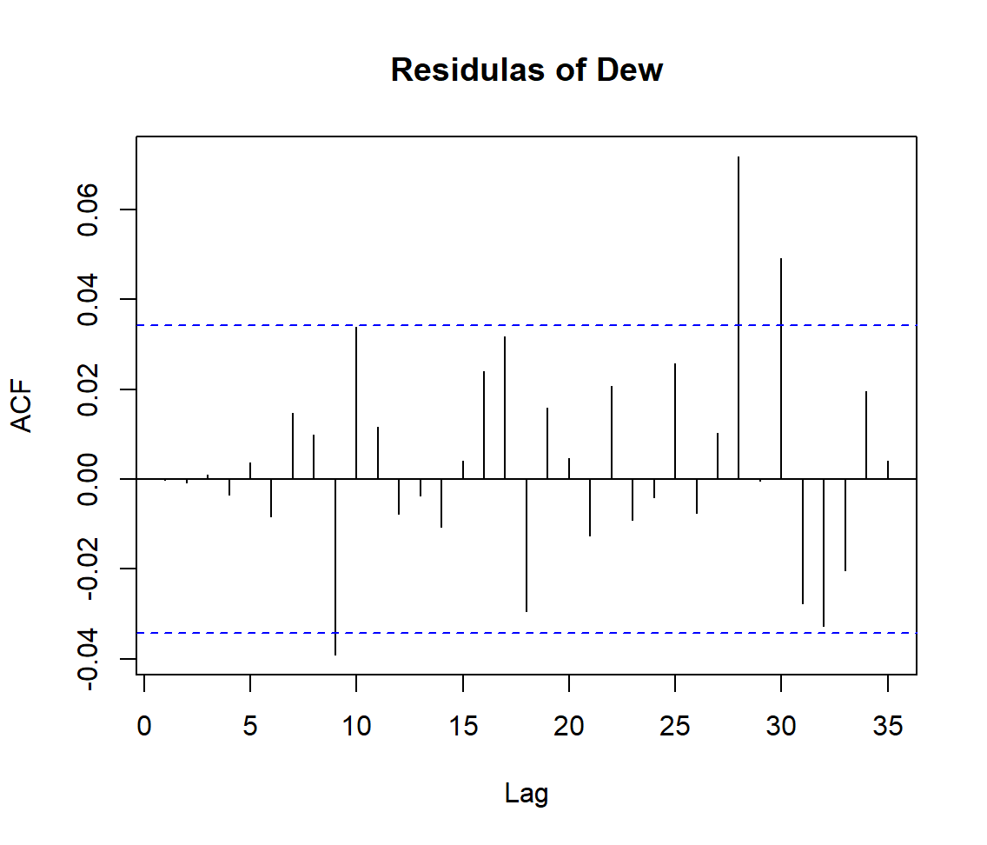
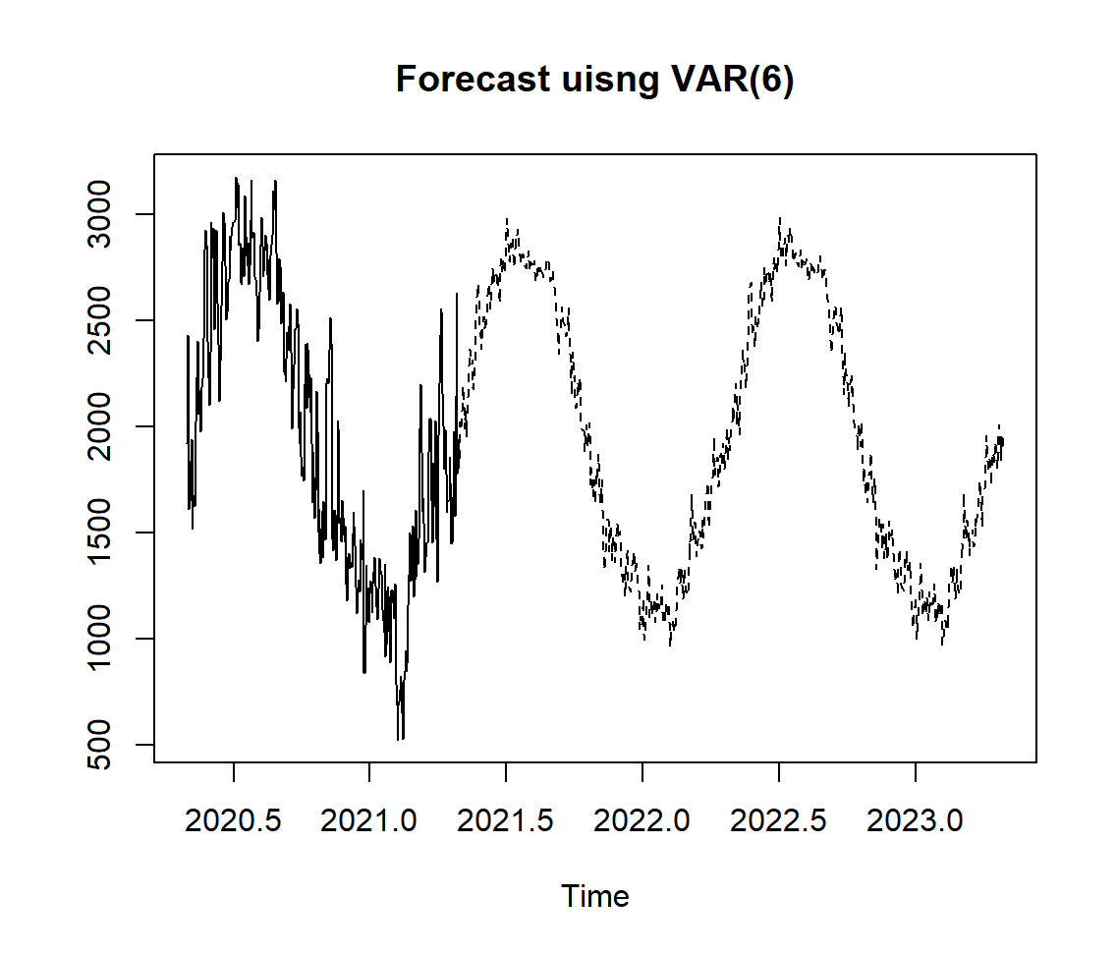
4.5. Modeling: VAR Model
The Vector Autoregression (VAR) model was used to capture the interdependencies between the temperature features, allowing for more comprehensive forecasting.
We noticed that dew was highly correlated with the target variable (temp), hence dew was used as an independent variable for the model. (Correlation = 0.96)
Used the VARSelect function and it reported the optimal model as VAR(6).
For the test data, VAR(6) reported the RMSE of 0.318 and AICc value of 84027.19
From the ACF plots, we inferred that the residuals of variables resembled white noise.

Slide 14
5. Model Evaluations and Selection
Evaluation Metrics:
The Root Mean Squared Error (RMSE) was utilized to measure the accuracy of the temperature predictions.
Additionally, we used the corrected Akaike Information Criterion (AICc), which takes into account both the model's goodness-of-fit and complexity, to compare and select the most suitable model.
Results:
Among the statistical models built, we found that the VAR model outperformed the other approaches in terms of RMSE. The AICc value was high due to high model complexity. To get a good balance between accuracy and model complexity we chose the Regression with ARIMA errors. The model effectively captured the autocorrelation and seasonality in the temperature data while incorporating the impact of differencing to achieve stationarity.

Slide 15
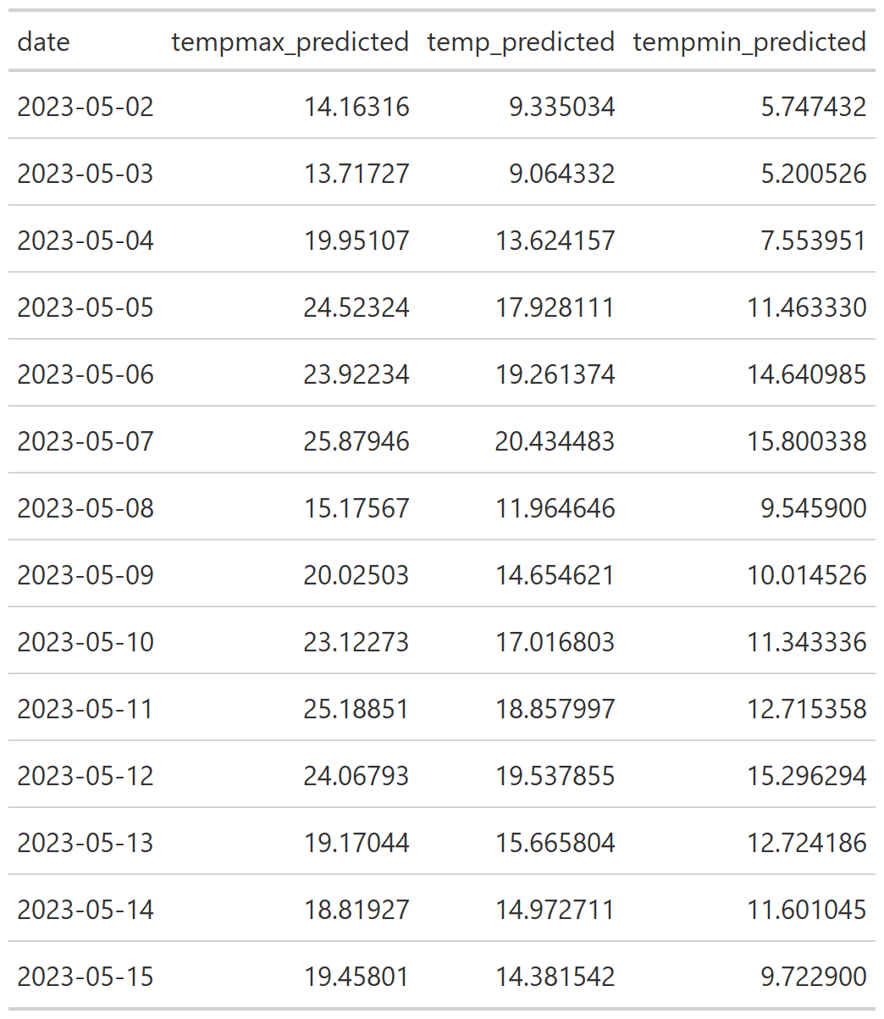
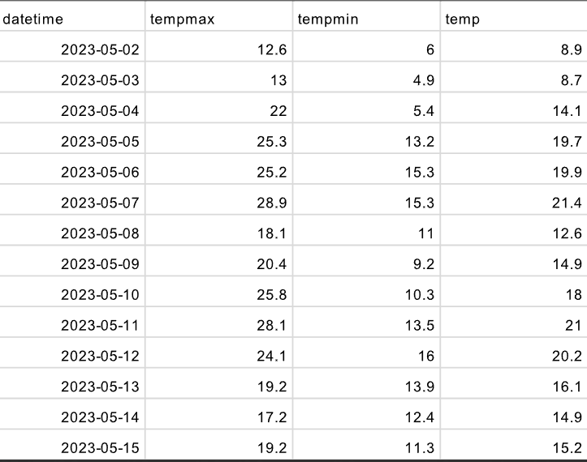
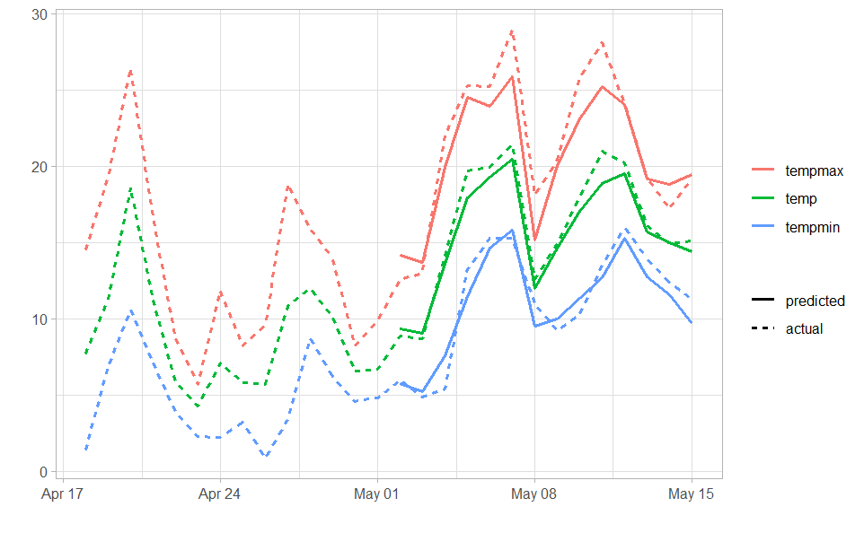
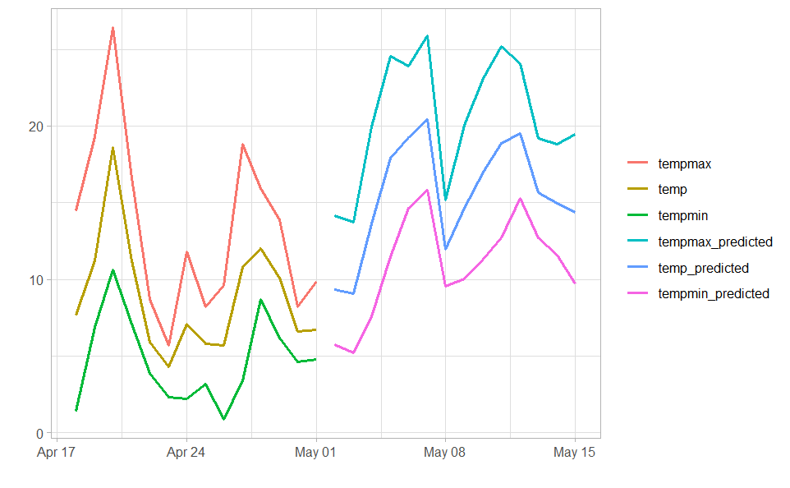
6. Forecasting: Using Selected Model
The below plot shows the forecasts of the best performing model - Regression with ARIMA errors
Forecasted Values
Actual Values
Note that in practice, the values of future independent variables are not known, so the above predictions cannot be made.

Slide 16
7. Insights and recommendations
Based on our findings, we offer the following recommendations:
Utilize the accurate temperature forecasts to optimize energy management strategies, such as load forecasting and resource allocation, ensuring efficient utilization of resources.
Incorporate the temperature forecasts into agricultural planning to improve crop yield predictions, irrigation scheduling, and pest management.
Leverage the temperature predictions for urban planning and infrastructure management, including heat wave preparedness, building design, and transportation optimization.
Support public health initiatives by using temperature forecasts to anticipate heat stress risks, plan for cooling centers, and implement heatwave warning systems.
Enhance decision-making in tourism and outdoor event planning by considering temperature variations and tailoring activities accordingly.

Slide 17
8. Conclusion and Future Work
This project lays the foundation for future research and improvements in temperature forecasting. Further work could involve:
Exploring ensemble methods or machine learning algorithms to potentially enhance the forecasting accuracy and capture non-linear relationships in the temperature data.
Investigating the impact of additional exogenous variables, such as solar radiation or air pollution levels, on temperature variations.
Conducting spatial analysis to extend the forecasting capabilities beyond Chicago and include neighboring regions.
Continuously updating and refining the forecasting model with new temperature data to adapt to evolving climate patterns and improve long-term predictions.

Slide 18
Appendix:
Github link: https://github.com/suyashlakhani/TimeSeries-Chicago-Temperature-Forecasting
Area of responsibility:
Data Exploration and Initial Analysis - Everyone
Exponential Smoothing - Daisuke Kageyama
ARIMA - Harsha Muthukuru
Regression with ARIMA errors - Yuki Hirayama
VAR - Isha Sharma
LSTM - Suyash Lakhani

Slide 19
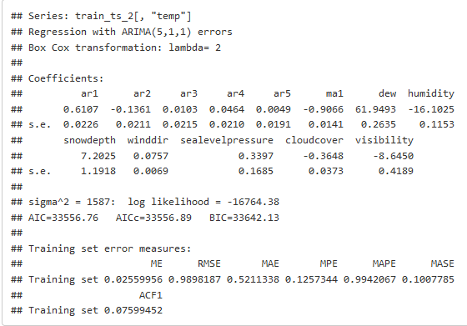
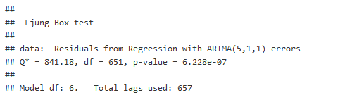
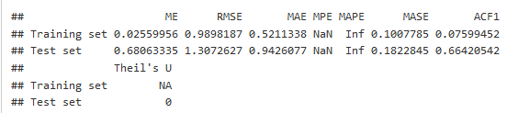
Appendix: Regression with ARIMA errors
Auto.arima()
checkresidual()
accuracy()

Slide 20
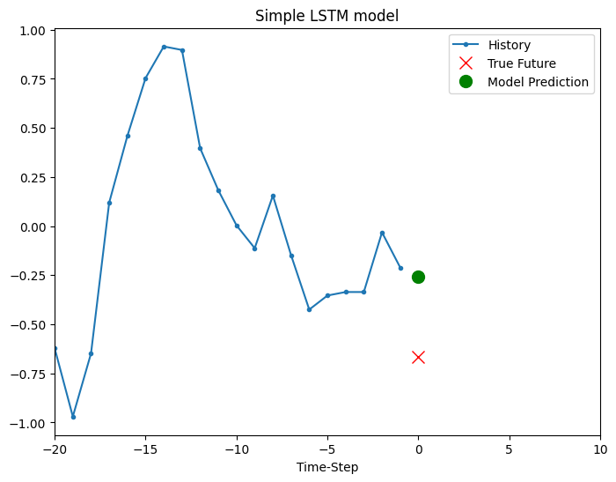
Appendix
Correlation matrix of different features with temperature
Actual vs Predicted values for LSTM

Slide 21
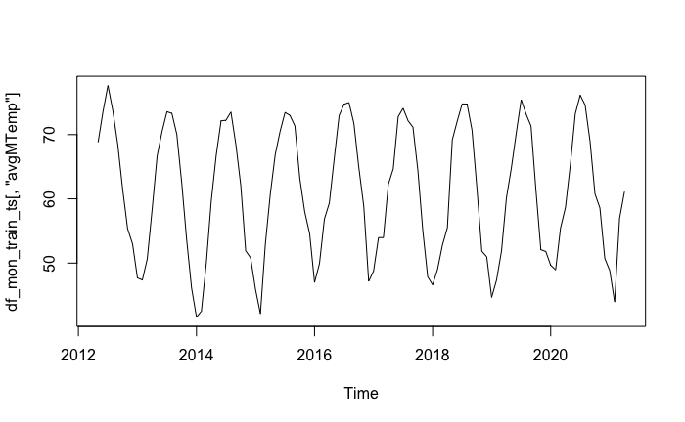
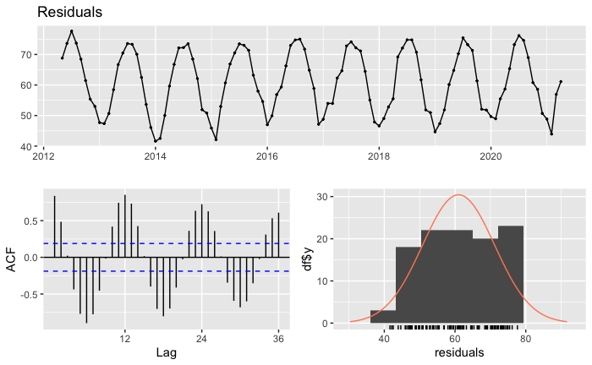
Appendix
We created the monthly average temperature from the daily average temperature for the Holt-Winters method, that is appropriate to the dataset with low frequency.
We did not take the first-order difference for the monthly data since Holt-Winters seasonal method does not require stationarity.

